Slide 1
Developing Integration Solutions using Microsoft BizTalk Server 2016
Adapters

Slide 2

Course Outline
Module 1: Introduction to BizTalk Server
Module 2: Schemas
Module 3: Maps
Module 4: Testing and Deploying BizTalk projects
Module 5: Pipelines
Module 6: Routing
Module 7: Adapters
Lesson 1: Introduction to Adapters
Lesson 2: Custom Adapters
Module 8: Web Services and WCF
Module 9: Introduction to Orchestrations
Module 10: Applied Orchestration Techniques
Module 11: Business Activity Monitoring
Module 12: Integrating Business Rules
Module 13: Deploying and Managing Applications
Extra modules

Slide 3
Lesson 1: Introduction to Adapters
What role do adapters play?
What is an Adapter?
Adapters in the BizTalk infrastructure
Protocol Adapters
Demonstration: Using a Protocol Adapter
Application Adapters
Demonstration: Using an Application Adapter

Slide 4




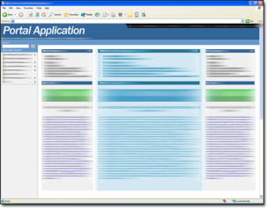




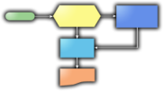








What role does adapters play?
WS-*
Packaged Apps
Web
Devices and People
Business Process
Cloud
Partner
Legacy
Trading Partners
LOB
Embedded

Slide 5





Where are adapters placed?

Slide 6
What is an adapter?
.NET or COM components
Allows BizTalk to communicate over some kind of protocol with another system
Can support a one way or two way Message Exchange Pattern (MEP)
Can handle metadata and message context
Adapter

Slide 7

Receive Adapters
Host
Responsible for delivering the message to BizTalk
Can support OneWay, Request/Response or Asynchronous callback MEPs.
Can add metadata to the message context before publishing the message to the MessageBox.
Receive Port
Receive Location
Adapter
Pipeline
Map
Message Box

Slide 8
Send Adapters
Host
Responsible for delivering the message from BizTalk to URI.
Can support OneWay or Solicit/Response MEPs.
Can use metadata delivered in the message context to make decisions on how to send message.
Send Port
Adapter
Pipeline
Map
Message Box

Slide 9
Where do I get adapters?
Out of the box – delivered with BizTalk
Extra adapters (comes with BizTalk installation media)
Line of Business Adapters (WCF adapters)
Adapters for Enterprise Applications
Host Integation Adapters
Offered by third party ISV’s.
For example /n software
Through the community
For example the SFTP, null, Tcp/ip, TALK adapters, among others.
Custom Adapters
Build it yourself using one of the available framworks.

Slide 10
Different kinds of adapters
Adapters are what enables BizTalk to communicate with applications through a multitude of protocols and methods without effort
Adapter Type | Description
Protocol Adapters | To bridge heterogeneous technologies and protocols Examples: HTTP, FTP, SMTP, SOAP/WCF, and MSMQ
Data Adapter | To connect to specific databases Examples: SQL Server, Oracle, and DB2
Application adapter | To connect to packaged and proprietary applications Examples: SharePoint, SAP, JDE, PeopleSoft, and Siebel

Slide 11
BizTalk Adapters and Accelerators
TECHNOLOGY
LOB
LEGACY (Host)
ADAPTER PACK
MQ
MSMQ
HTTP
SMTP
File
FTP
SFTP
POP3
SQL (deprecated)
WCF (7 Bindings)
SOAP (deprecated)
SharePoint
PeopleSoft
JD Edwards
OneWorld XE
JD Edwards
Enterprise1
Oracle ODBC
Siebel
TIBCO Rendezvous
TIBCO EMS
SAP
Microsoft Dynamics
Microsoft Commerce Server
Host Applications
IBM mainframe zSeries (CICS and IMS)
Midrange iSeries (AS/400)
IBM DB2
Mainframe DB2 for z/OS
Midrange DB2/400
DB2 Universal Database for open platforms (AIX, Linux, Solaris, and Windows)
Host Files
Websphere MQ
SAP
Oracle DB
Siebel
Oracle EBS
SQL Server
Accelerators
EDI
SWIFT
HIPPA
HL7
RosettaNet

Slide 12
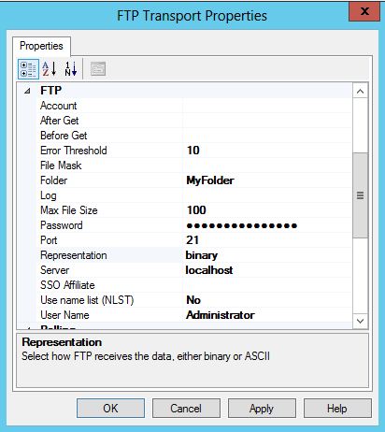
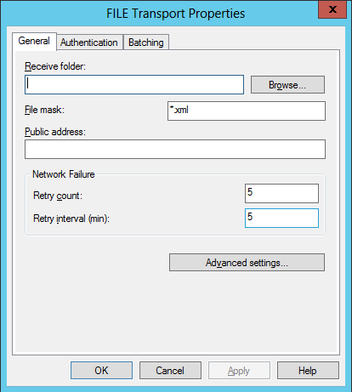
Protocol adapters
Protocol adapters included in BizTalk Server 2016:
FILE
FTP
POP3
SMTP
WCF
SFTP
FTPS
FTP
FILE

Slide 13

Demo
Using protocol adapters
File adapter
Using macros
FTP adapter
Notes:
(Slide 13)
Prepare
Create a new FTP site named Mod7, point to C:\Demos\Mod7\FTP
Allow Read and Write.
Demo
FILE
Show how to download the chm help file.
Show the FILE Adapter Macros, Import Mod7Bindings.xml
Use the %SourceFileName% macro, use the %datetime% macro.
Set receive mask as Copy of*
Set send mask as OUT_%macro%.xml
FTP
Create FTP Receive and Send ports.
Fill in File mask/Target file name, Server, Folder, User Name, Password
Highlight other commands, After and Before commands, polling options.

Slide 14
Application adapters
Line of Business (LOB) adapters (Installed by default)
SharePoint
SQL (deprecated)
Line of Business (LOB) adapters (Optional install)
mySAP Business Suite
Oracle Database
Oracle E-Business Suite
Siebel sBusiness Applications
SQL Server

Slide 15
Application adapters
Adapters for Enterprise Applications (Optional install)
JD Edwards OneWorld XE
JD Edwards EnterpriseOne
ODBC for Oracle
Oracle eBusiness Suite
Tibco Rendezvous
Tibco Enterprise Message Service
PeopleSoft Enterprise
SAP
Other Application Adapters (Optional install)
Host Applications
IBM DB2
Host Files
WebSphere MQ

Slide 16
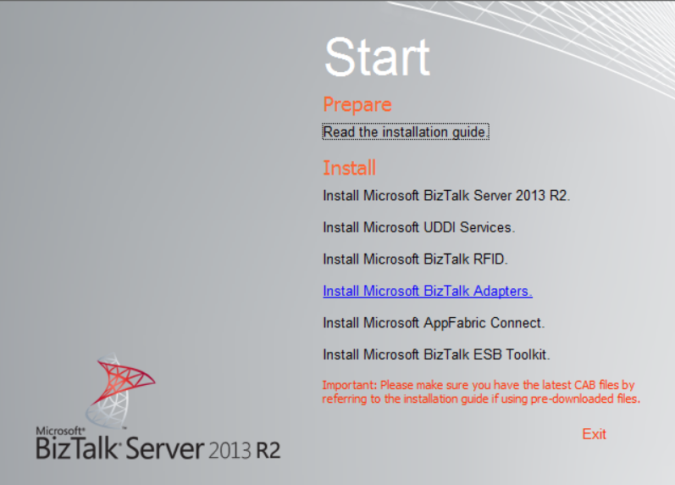
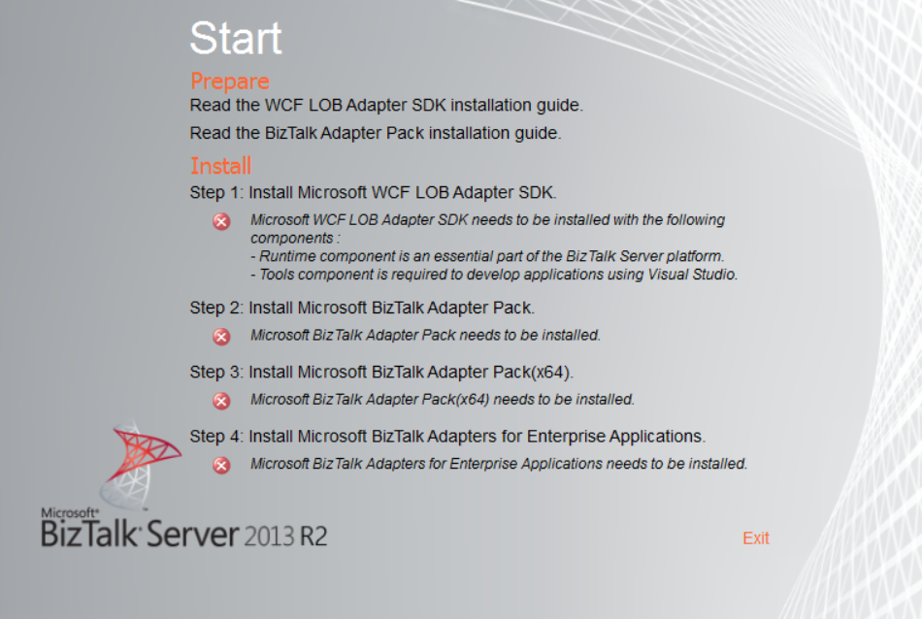
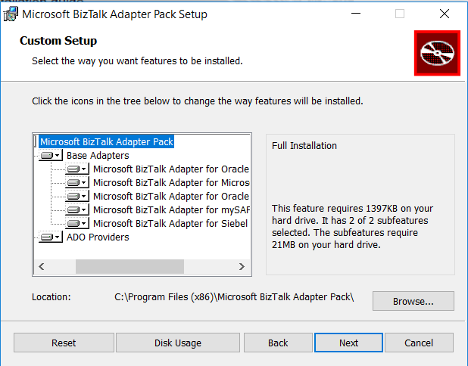
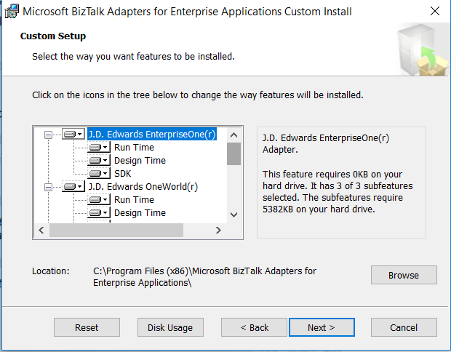
Installing additional adapters

Slide 17
Demo
Using an application adapter
WCF-SQL Adapter

Slide 18


Logic App Adapter
200 Connectors/Adapters
Notes:
LAAdapter01 – Postman > LA > BizTalk

Slide 19
Lesson 2: Custom Adapters
Developing custom adapters

Slide 20
Custom Adapters
Developed as a c# class library
Use the BizTalk Adapter Framework
Still viable, might not be preferred
API to BizTalk shared services
Templates and samples for creating custom adapters
Works like any built in adapter
Use the WCF LOB Adapter SDK
New initiative from Microsoft
Not really BizTalk – WCF!
Use through WCF-Custom/CustomIsolated adapter as a binding.

Slide 21
Summary
Adapters are the part of the BizTalk Server infrastructure that delivers messages to and from BizTalk Server to other applications, places or data sources.
There is a wide range of adapters available for BizTalk Server.
You can develop your own adapters – but it’s not an easy task.

Slide 22
Q & A
Adapters

Slide 23
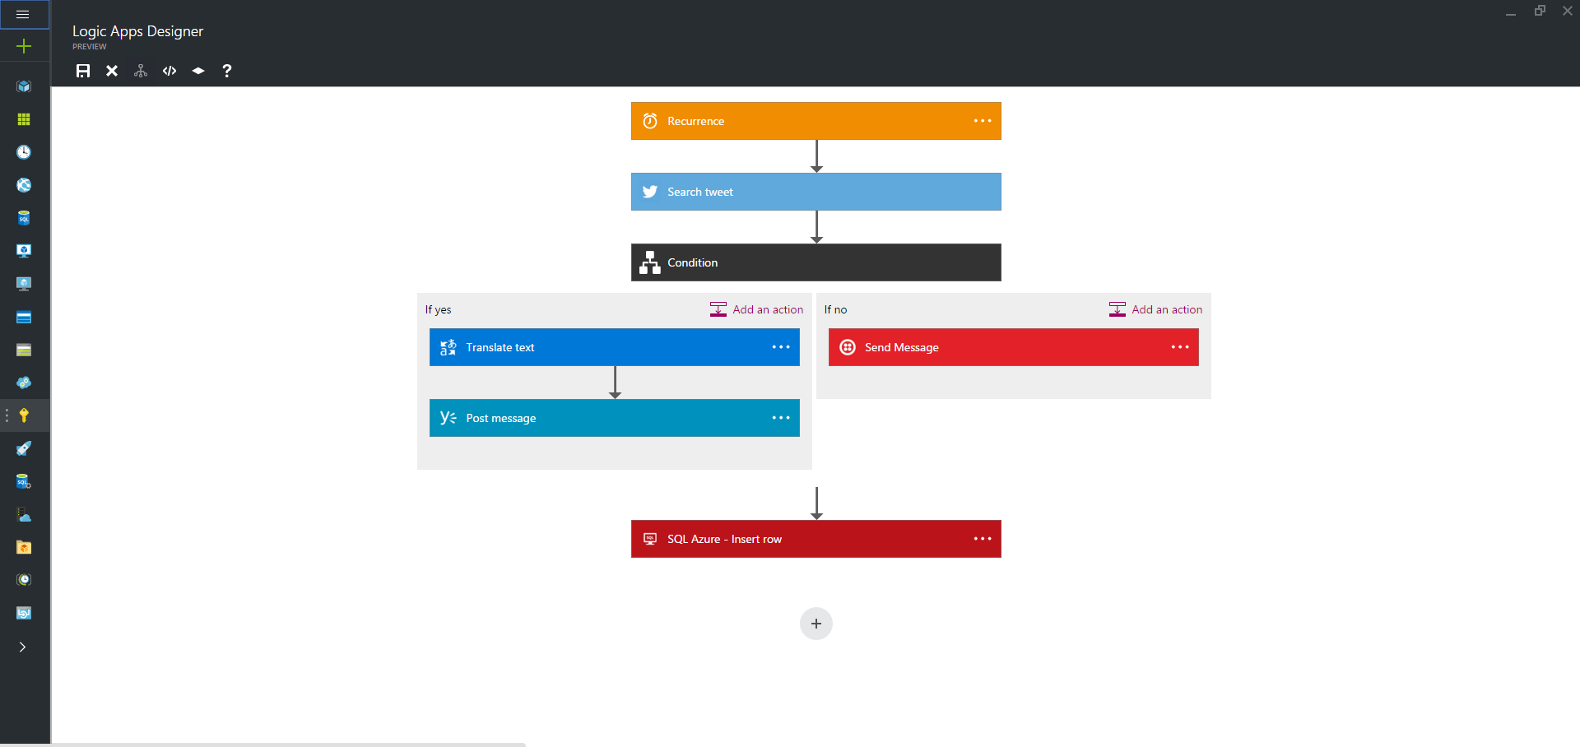
BTSHOL07b Integration with Azure Logic Apps
Logic Apps orchestrates messages through a set of API Apps.
Logic Apps can not handle code.
Logic Apps are hosted in Azure.

Slide 24




BTSHOL07b Integration with Azure Logic Apps
Twitter
Logic App
BizTalk
MS SQL

Slide 25

BTSHOL07b Integration with Azure Logic Apps
Logic App
Service Bus
BizTalk

Slide 26


What is a Queue and what is a Topic
Message
Message
Queue
Consumer
Subscription
Message
Topic
Subscription
Message

Slide 27


Hands-On-Labs
Integration with Azure Logic Apps
Trainer builds Logic Apps and provides subscriptions for each student
(Students) creates Receive Locations picking messages of the subscriptions
Create Orchestration to handle the on-premise process
Create WCF-SQL Send port

Slide 28

Quiz
What are the three categories of adapters?
What is the responsibility of adapters?
Where do adapters run?

